Slide 1

Union-Find Partition Structures
Union-Find
Notes:
Minimum Spanning Tree

Slide 2
Partitions with Union-Find Operations
makeSet(x): Create a singleton set containing the element x and return the position storing x in this set
union(A,B ): Return the set A U B, destroying the old A and B
find(p): Return the set containing the element at position p
Union-Find

Slide 3
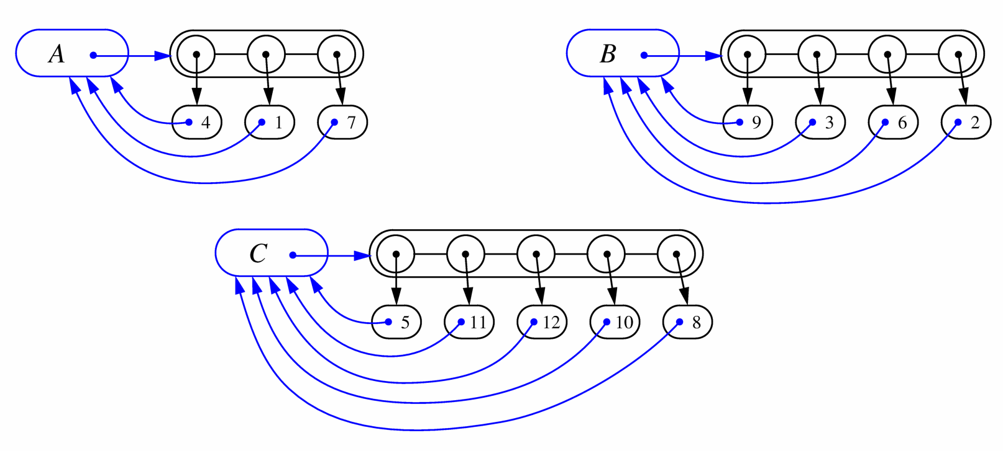
List-based Implementation
Each set is stored in a sequence represented with a linked-list
Each node should store an object containing the element and a reference to the set name
Union-Find

Slide 4
Analysis of List-based Representation
When doing a union, always move elements from the smaller set to the larger set
  Each time an element is moved it goes to a set of size at least double its old set
  Thus, an element can be moved at most O(log n) times
Total time needed to do n unions and finds is O(n log n).
Union-Find

Slide 5
Tree-based Implementation
Each element is stored in a node, which contains a pointer to a set name
A node v whose set pointer points back to v is also a set name
Each set is a tree, rooted at a node with a self-referencing set pointer
For example: The sets “1”, “2”, and “5”:
1
2
5
4
7
3
6
8
10
9
11
Union-Find
12

Slide 6
Union-Find Operations
5
To do a union, simply make the root of one tree point to the root of the other
To do a find, follow set-name pointers from the starting node until reaching a node whose set-name pointer refers back to itself
2
8
10
3
6
11
9
12
5
2
8
10
3
6
11
9
12
Union-Find

Slide 7
Union-Find Heuristic 1
Union by size:
  When performing a union, make the root of smaller tree point to the root of the larger
Implies O(n log n) time for performing n union-find operations:
  Each time we follow a pointer, we are going to a subtree of size at least double the size of the previous subtree
  Thus, we will follow at most O(log n) pointers for any find.
5
2
8
10
3
6
11
9
12
Union-Find

Slide 8
Union-Find Heuristic 2
Path compression:
  After performing a find, compress all the pointers on the path just traversed so that they all point to the root
Implies O(n log* n) time for performing n union-find operations:
  Proof is somewhat involved… (and not in the book)
5
5
8
10
8
10
11
11
2
12
2
12
3
6
3
6
9
9
Union-Find

Slide 9
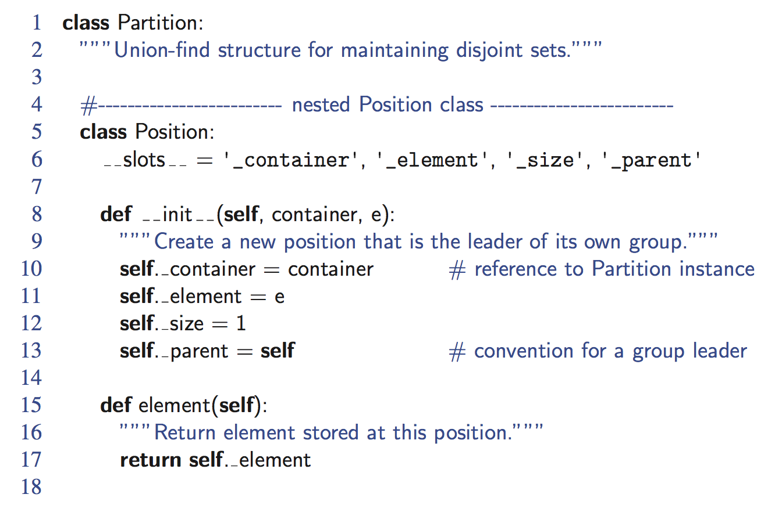
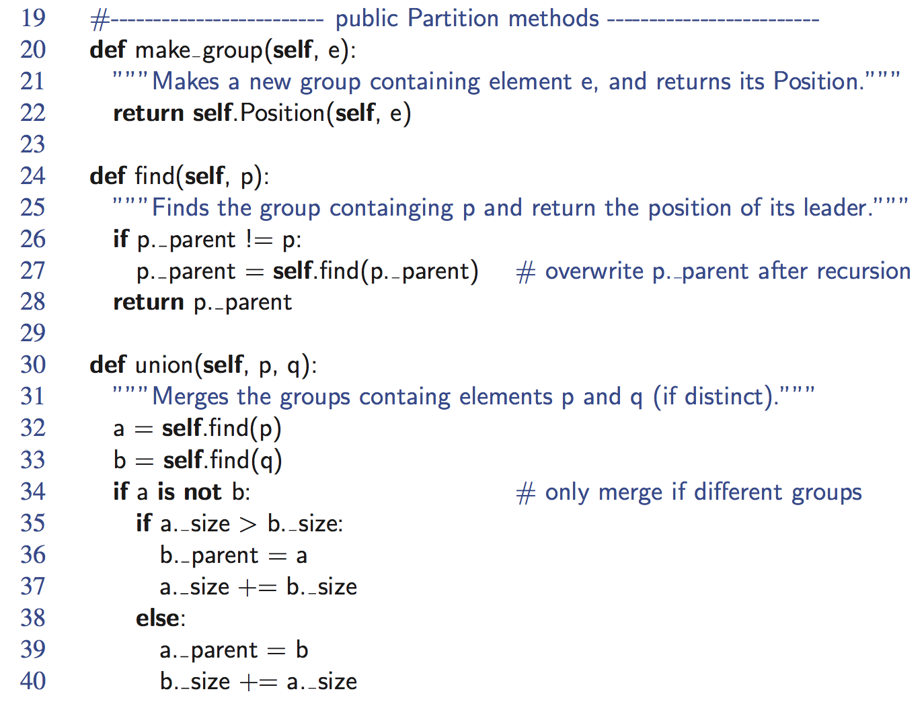
Python Implementation
Union-Find

Slide 10
Proof of log* n Amortized Time
For each node v that is a root
  define n(v) to be the size of the subtree rooted at v (including v)
  identified a set with the root of its associated tree.
We update the size field of v each time a set is unioned into v. Thus, if v is not a root, then n(v) is the largest the subtree rooted at v can be, which occurs just before we union v into some other node whose size is at least as large as v ’s.
For any node v, then, define the rank of v, which we denote as r (v), as r (v) = [log n(v)]:
Thus, n(v) ≥ 2^{r(v)}.
Also, since there are at most n nodes in the tree of v, r (v) = [log n], for each node v.
Union-Find

Slide 11
Proof of log* n Amortized Time (2)
For each node v with parent w:
  r (v ) > r (w )
Claim: There are at most n/ 2^{s} nodes of rank s.
Proof:
  Since r (v) < r (w), for any node v with parent w, ranks are monotonically increasing as we follow parent pointers up any tree.
  Thus, if r (v) = r (w) for two nodes v and w, then the nodes counted in n(v) must be separate and distinct from the nodes counted in n(w).
  If a node v is of rank s, then n(v) ≥ 2^{s}.
  Therefore, since there are at most n nodes total, there can be at most n/ 2^{s} that are of rank s.
Union-Find

Slide 12
Proof of log* n Amortized Time (3)
Definition: Tower of two’s function:
  t(i) = 2^{t(i-1)}
Nodes v and u are in the same rank group g if
  g = log*(r(v)) = log*(r(u)):
Since the largest rank is log n, the largest rank group is
  log*(log n) = (log* n) - 1
Union-Find

Slide 13
Proof of log* n Amortized Time (4)
Charge 1 cyber-dollar per pointer hop during a find:
  If w is the root or if w is in a different rank group than v, then charge the find operation one cyber-dollar.
  Otherwise (w is not a root and v and w are in the same rank group), charge the node v one cyber-dollar.
Since there are most (log* n)-1 rank groups, this rule guarantees that any find operation is charged at most log* n cyber-dollars.
Union-Find

Slide 14
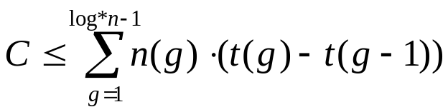
Proof of log* n Amortized Time (5)
After we charge a node v then v will get a new parent, which is a node higher up in v ’s tree.
The rank of v ’s new parent will be greater than the rank of v ’s old parent w.
Thus, any node v can be charged at most the number of different ranks that are in v ’s rank group.
If v is in rank group g > 0, then v can be charged at most t(g)-t(g-1) times before v has a parent in a higher rank group (and from that point on, v will never be charged again). In other words, the total number, C, of cyber-dollars that can ever be charged to nodes can be bounded by
Union-Find

Slide 15
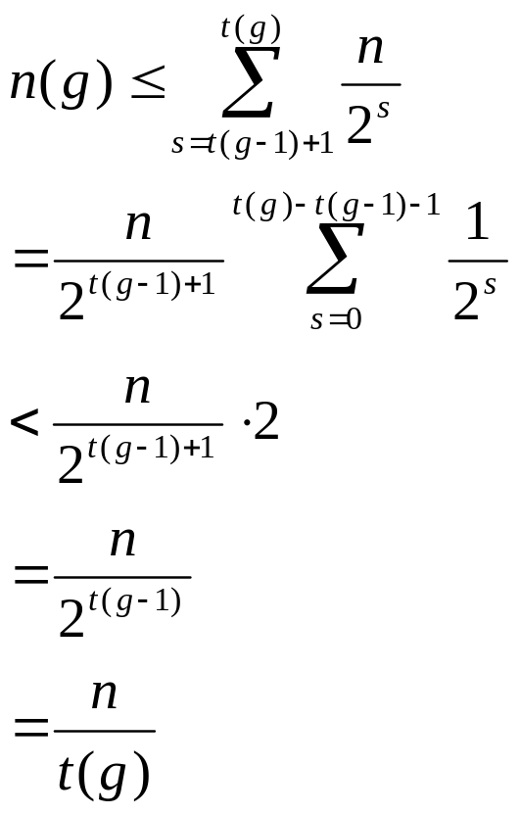
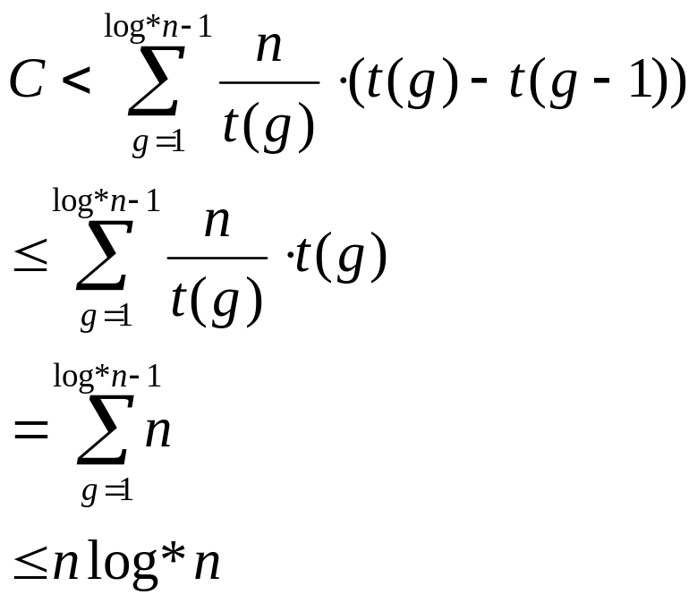
Proof of log* n Amortized Time (end)
Bounding n(g):
Returning to C:
Union-Find

